Slide 1

Empowering
Global Teams
Todd Little
VP Product Development
IHS

Slide 2
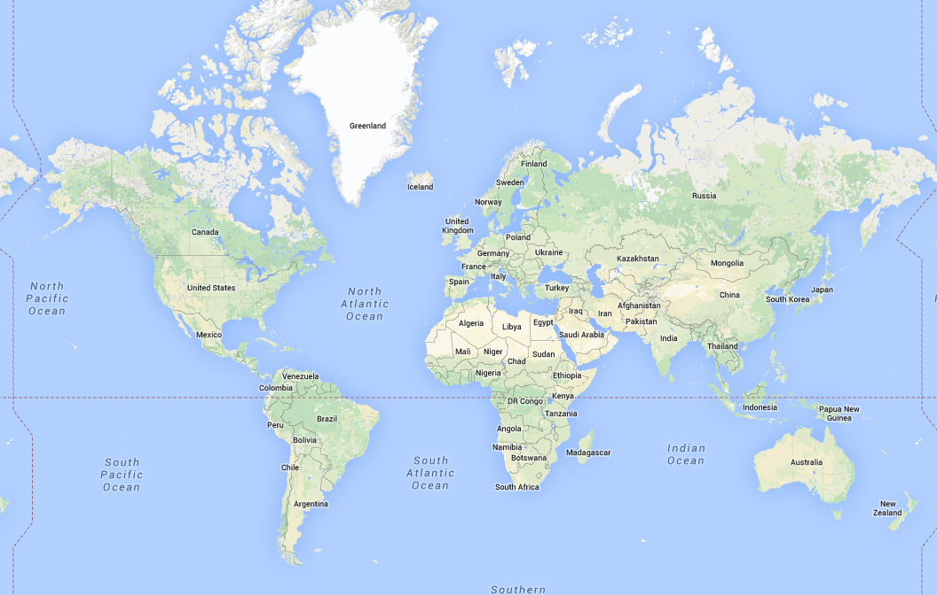
Globally Distributed Teams

Slide 3
Distributed Agility
What are the biggest challenges with distributed teams?

Slide 4
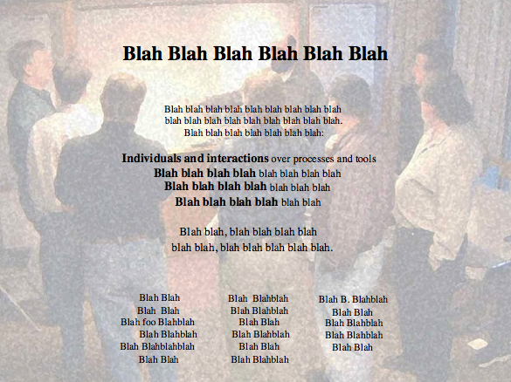

Slide 5
Long Ago and Far, Far Away…

Slide 6
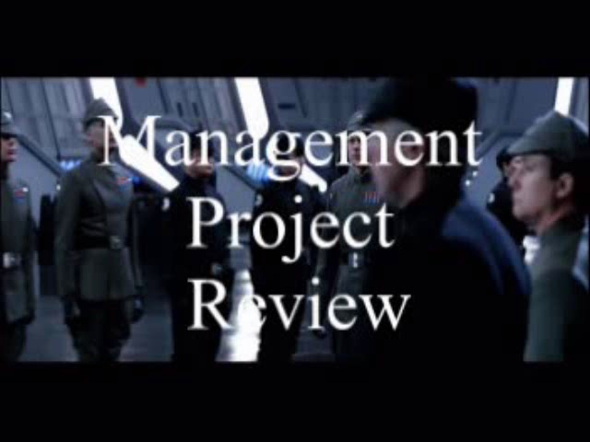

Slide 7

Agile Leadership

Slide 8
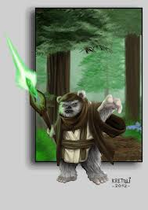

From Coding Monkey to Empowered Ewok

Slide 9
Trust/Ownership Model
Trust
Abdication
Energy & Innovation
How do we
get here?
Micromanagement
Conflict
Control
Low
Team Ownership
High

Slide 10
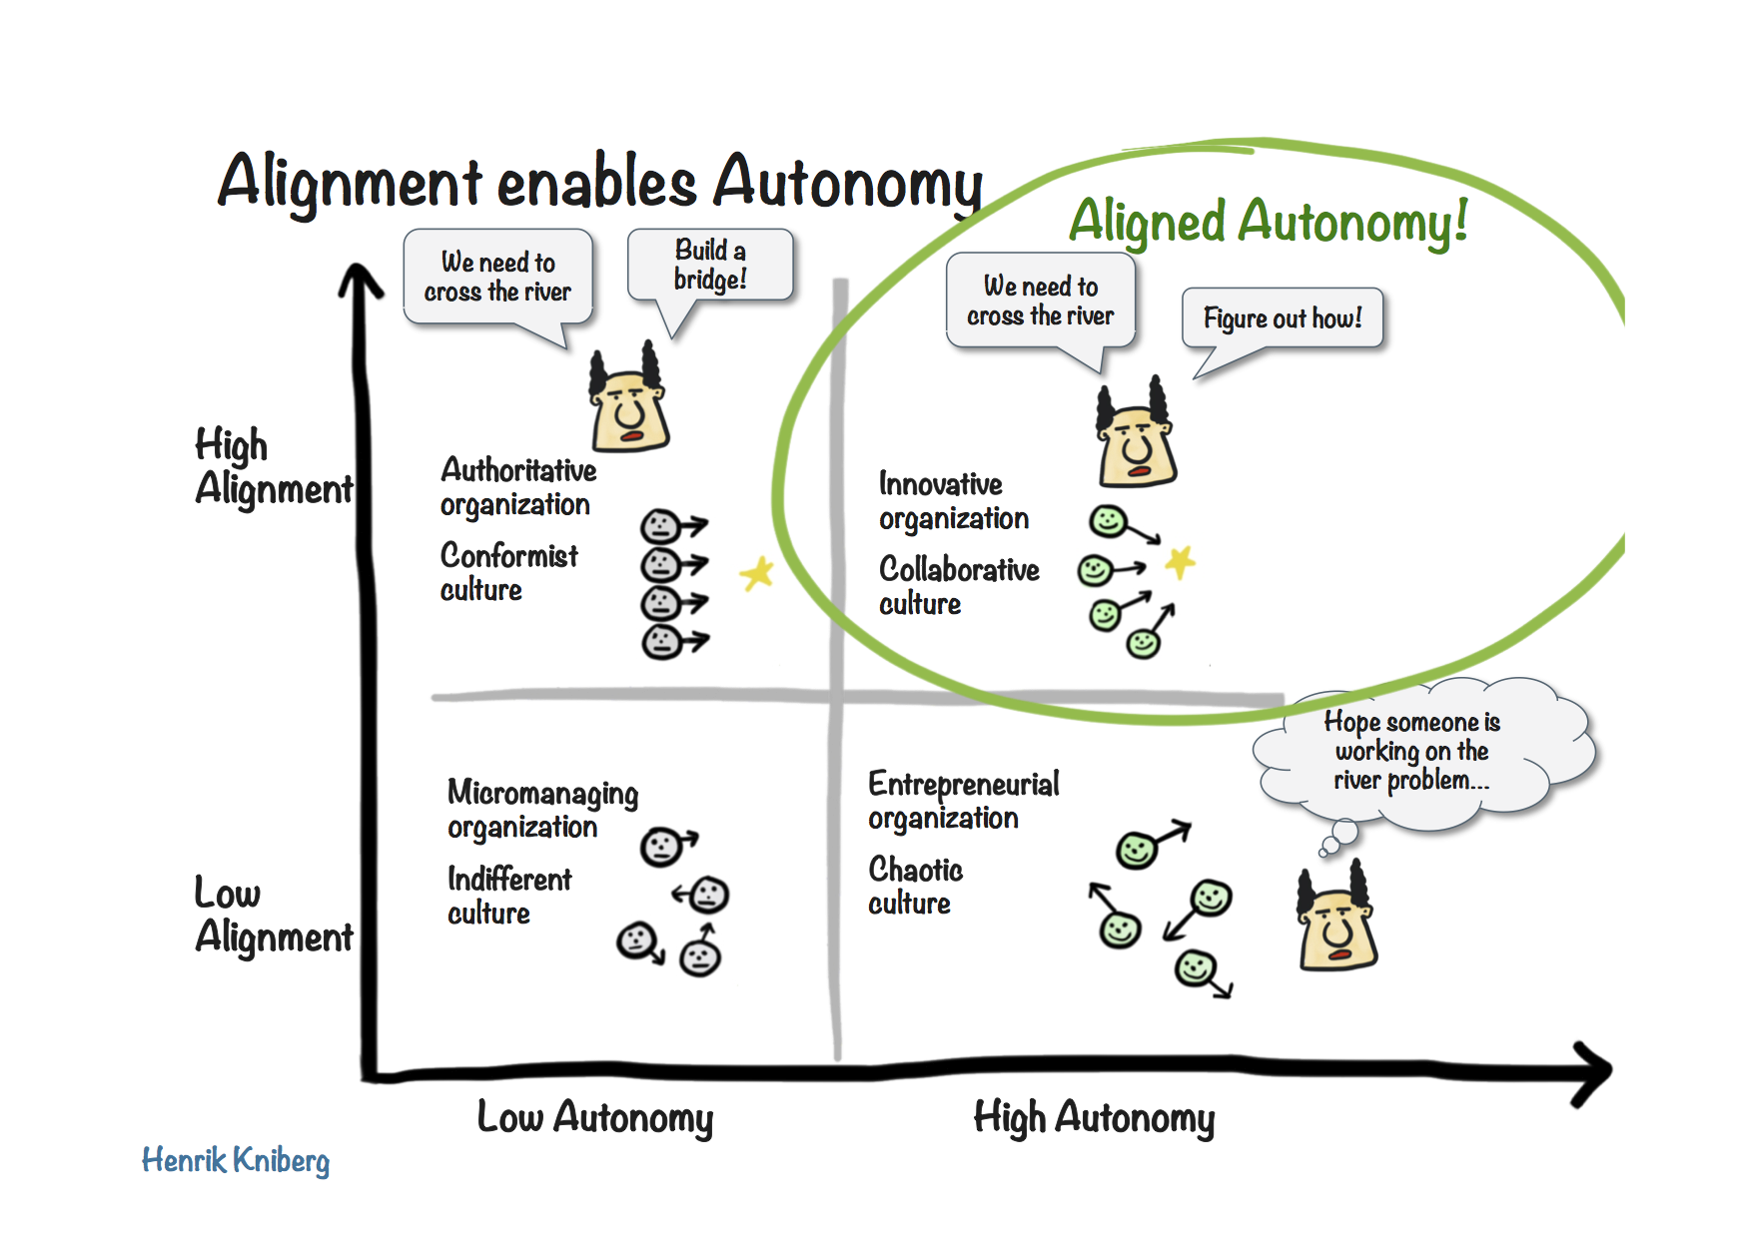
Autonomy and Alignment

Slide 11



Case Study I
Integrating Software by Integrating People
Oil and Gas Software Company Acquires Market Leaders in each Sub-Domain
Value Proposition is in creating integrated workflows

Slide 12
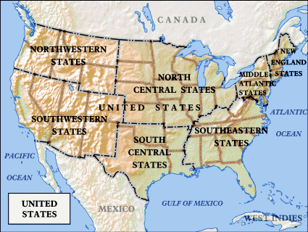
But software is developed in Houston, Austin, Denver and Calgary

Slide 13
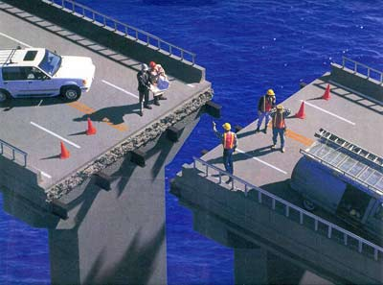
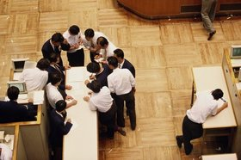
What the Leaders Did
The best way to integrate our software is to make sure we integrate our people

Slide 14



Get Alignment on the Purpose
Value Proposition is in creating integrated workflows
Input
Output
I² Enterprise

Slide 15
Integrating People
Creating the Future
Friday@4 Weekly
PMM Quarterly
Developers’ Conference Yearly

Slide 16
Creating the Future
One Week exposure to Landmark
All new employees from around the world

Slide 17

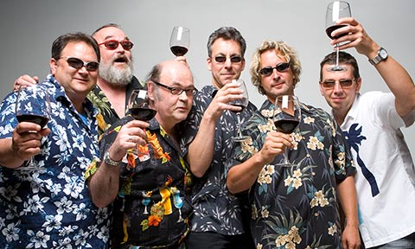
Friday’s @ 4
Informal setting
Opportunity for news

Slide 18
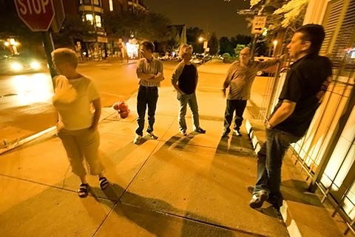

Product/Project Managers’ Meeting
Quarterly
Face to Face
2 days

Slide 19
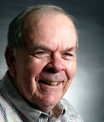
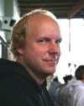
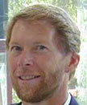
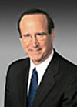
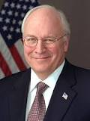
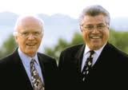
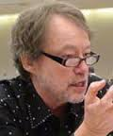
WorldWide Developers’ Conference
4 Day event
Annual
Everyone collocated
People
Purpose
Passion

Slide 20


The Bottom Line
Revenue grew
Market share grew

Slide 22
Alas
x
Creating the Future
Friday@4 Weekly
x
PMM Quarterly
x
Developers’ Conference Yearly
x

Slide 23

Struggle to Re-Invent

Slide 24
Case Study II
Too many Indians, not enough Chiefs
A 5 year arrangement with an outsourcer had not progressed as rapidly as Sr. Executives had hoped

Slide 25
Case Study II
Too many Indians, not enough Chiefs
Find an outsourcer that will promise that they will provide good talented developers and strong domain experts.
Join and Jolt – 3 times. Then finally hire one that was pretty good. Lasted 2 months.
Software developers not so strong either.

Slide 26
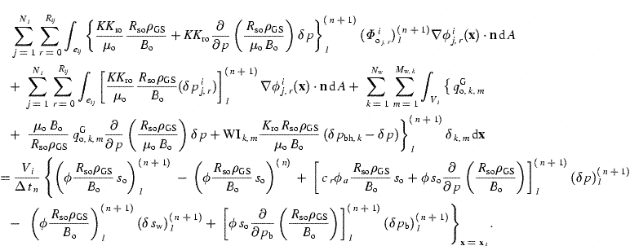
Petroleum Reservoir Simulation
It’s NOT Rocket Science

Slide 27
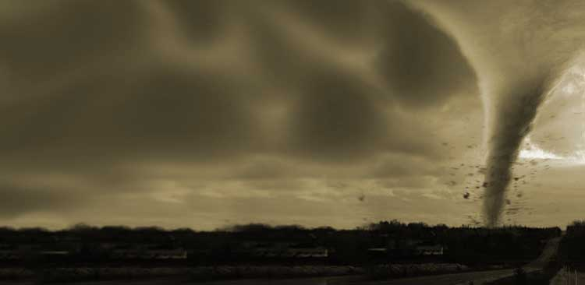



Managing the Coming Storm
Inside the Tornado
Project Kickoff
When will we get the requirements?
All in good time, my little pretty, all in good time
But I guess it doesn't matter anyway
Just give me your estimates by this afternoon
Team Unity
Not so fast! Not so fast! ... I'll have to give the matter a little thought. Go away and come back tomorrow
No, we need something today!
Ok then, it will take 2 years.
No, we need it sooner.
Doesn't anybody believe me?
I already promised the customer it will be out in 6 months
You're a very bad man!
Notes:
We look at a typical software project…..

Slide 28


We’re not in Kansas Anymore
Developer Hero
I may not come out alive, but I'm goin' in there!
Reorg
The Great and Powerful Oz has got matters well in hand.
My! People come and go so quickly here!
Testing
"Hee hee hee ha ha! Going so soon? I wouldn't hear of it! Why, my little party's just beginning!

Slide 29


What We did
Romania
  3 Software Developers
  3 Reservoir Simulation Experts
  Owner was Professor of Reservoir Simulation (and a benevolent dictator)
  Communicated in the language of reservoir simulation
Vietnam
  4 automation test experts
  Specialized in Action Based Testing
  Communication from domain experts (US and Romania) via Camtasia videos.
3 Dev
3 PE Test

Slide 30
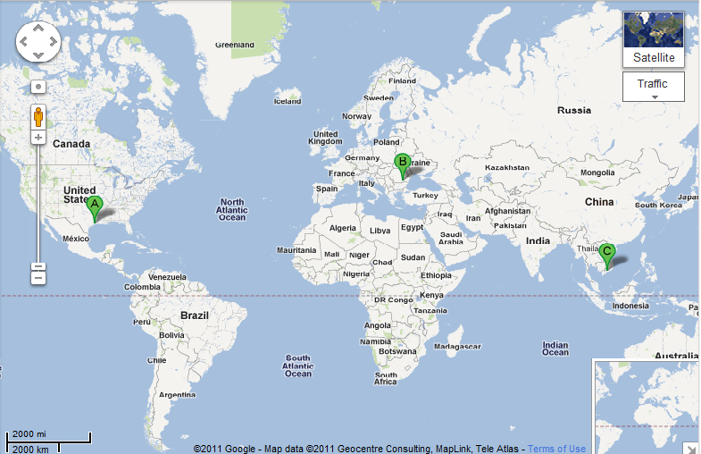
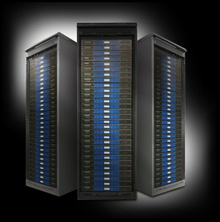
Global Expertise
(Houston, Bucharest, Ho Chi Minh City)
3 Dev
3 PE Test
15 Dev
6 PE Test
2 Pgm Mgr
2 Prod Mgr
4 Auto Test

Slide 31
The Bottom Line
97% Reduction

Slide 32
Distributed Challenge: Time Shift
8 hours
12 hours

Slide 33

Think Globally and Optimize the Whole

Slide 34
Leadership and Domain Matters

Slide 35
Empowered Distributed Teams
Autonomy
Leadership
Domain
Dev
Test
Trust
Ownership

Slide 36
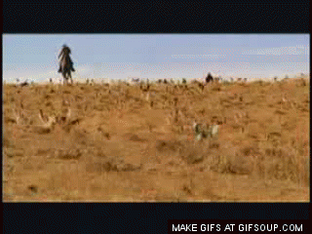
Case Study III
From Herding CATS to Pussycats

Slide 37

Grumpy CATS
3 years into a “1 year” project

Slide 38
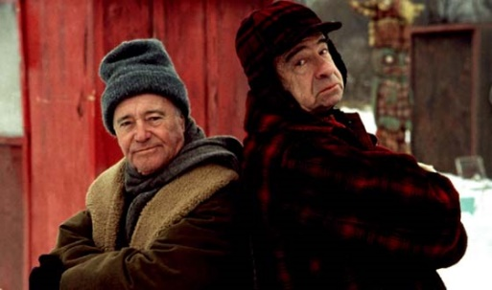
Grumpy Old Men (and Women)

Slide 39
Globally Distributed Teams

Slide 40
Everyone had suggestions
Business: We need a new manager to hold them accountable!
PMO: Their process is broken. They should be using SAFe!
Dev Team: The Business doesn’t know what they need!
Dev Team: We know what we are doing! Just let us do it!
Dev Team: The team in India requires too much babysitting!
Project Manager: India team has capacity but US team doesn’t give them anything
Business: The India team are the only ones that demo at the showcase!
Bossman: Just Fix It!

Slide 41
What I did
Agile Coaching
  Changed how team used Story Points
  Produced a meaningful Release Backlog
  Extracted development velocity and scope creep
  Projected out realistic delivery date (7 months later than they had signed up for)

Slide 42
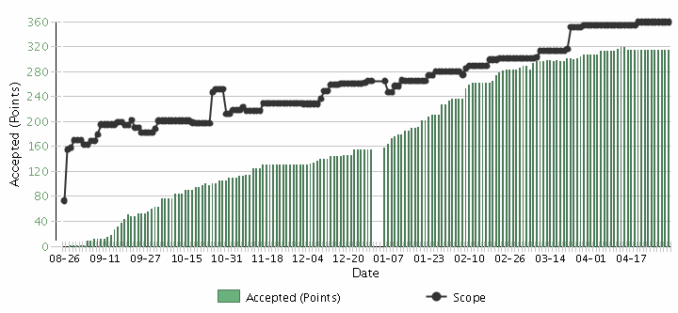
Burnup Chart
Scope Creep
Velocity

Slide 43
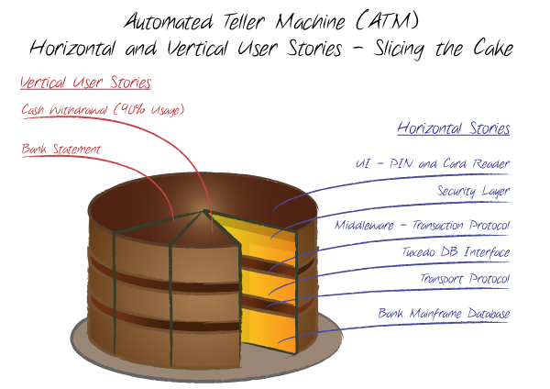
What I did
Agile Coaching (part II)

Slide 44
What I did
Staffing
  I didn’t change the manager
  Replaced the 4 India contractors with 2 US employees
  Added 2 developers at IHS Bangalore office with strong Oil & Gas background

Slide 45
Trust/Ownership Model
Trust
Abdication
Energy & Innovation
Dev Team
Micromanagement
Conflict
Business
Control
Low
Team Ownership
High

Slide 46

Collaborating with Non-Collaborators
Collaborator
Creative
Tension
Collegial
More useful
Drive to
Purpose
Collaboration
Non-
Collaborator
Compliance
Combative
Common Practice
Agree
Disagree
Agreement

Slide 47
From Grumpy CATS to Pussycats

Slide 49

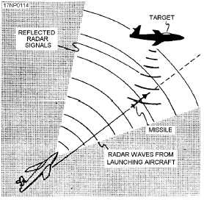
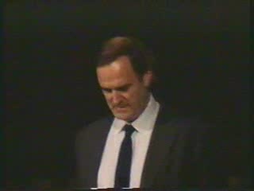
Gordon the Guided Missile

Slide 50
Control Systems
Processes
Inputs
Inputs
Inputs
Command & Control
Processes
Inputs
Inputs
Inputs
Agile Leadership
Outputs

Slide 51
Trust/Ownership Model
Trust
Abdication
Energy & Innovation
How do we
get here?
Zone of
Stable Control
Micromangement
Conflict
Control
Low
Team Ownership
High

Slide 53
Empowered Distributed Teams
Autonomy
Leadership
Domain
Dev
Test
Trust
Ownership

Slide 54
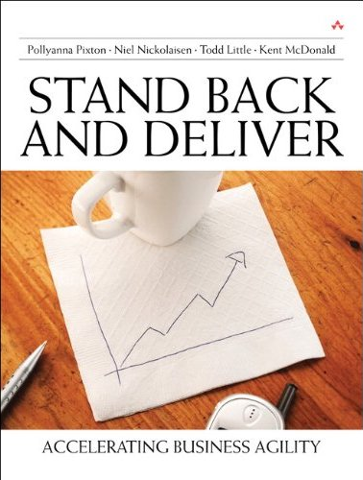

Contact
Todd Little
  todd.little@ihs.com
  toddelittle@gmail.com
  www.toddlittleweb.com
  www.accelinnova.com
May the Force Be With You

Slide 55




Integrating Offshore Teams
A - Onshore
  Technical Leader of Offshore team
B - Offshore
  Offshore Team Lead
  Domain Specialist
  2-3 Developers
  Testers
C – Offshore
  Junior Developers and Testers

